Slide 1
Electricity and Magnetism
Physics 259 – L02
Lecture 45
Lecture by: Mr Tahani

Slide 2
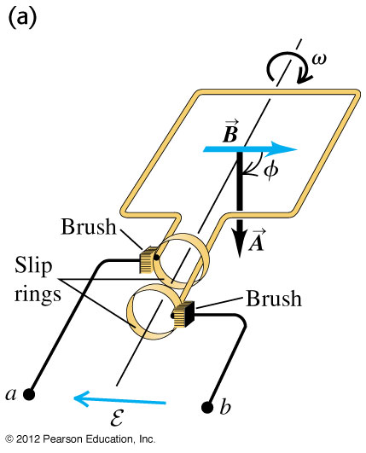

Application: a simple alternator
An alternator is an electromechanical device that converts mechanical energy to electrical energy in the form of alternating current. In principle, any AC electrical generator can be called an alternator.
Alternators are used in cars to charge the battery and to power the electrical system when its engine is running. In practice, the loop is stationary and a magnet rotates.

Slide 3
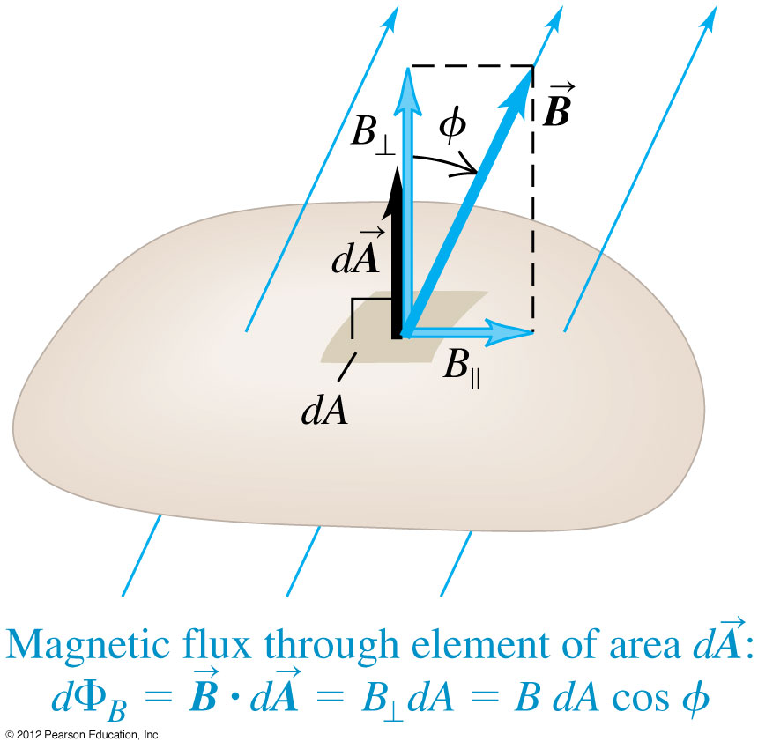
Application: a simple alternator
The magnetic field and the area are constant, but the angle between the two changes constantly
φ=ωt
Hence, the time-dependent magnetic flux is
φ_{B}=BA cosφ = BA cosωt
The alternator thus generates a sinusoidally varying EMF
ε = - dφ_{B}/dt
= - (-ωBA sinωt)
= ωBA sinωt

Slide 4
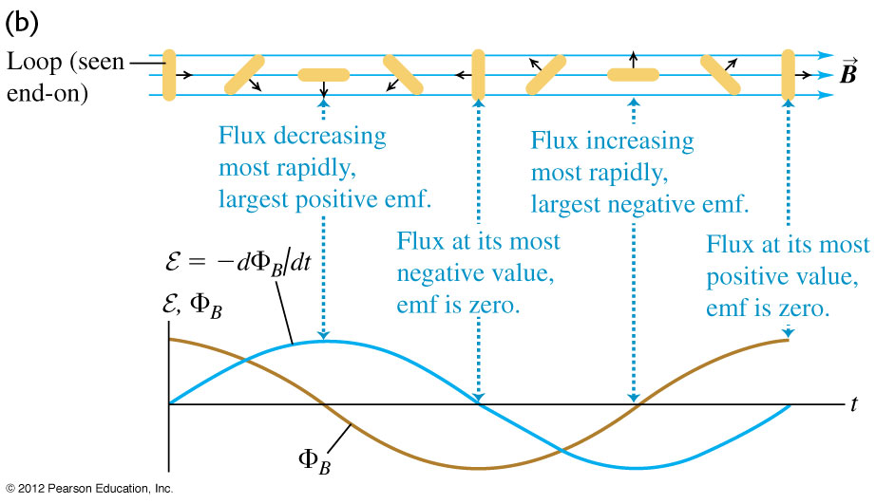
Application: a simple alternator
Φ = ωt
φ_{B}= BA cosφ = BA cosωt
ε = - dφ_{B}/dt
= ωBA sinωt

Slide 5
Top Hat Question
An oval shaped loop is spun around an axis pointing out of the page passing through the center of the loop. Is there a current (or EMF) induced in the loop?
A: Yes, there is
B: No, there is not

Slide 6
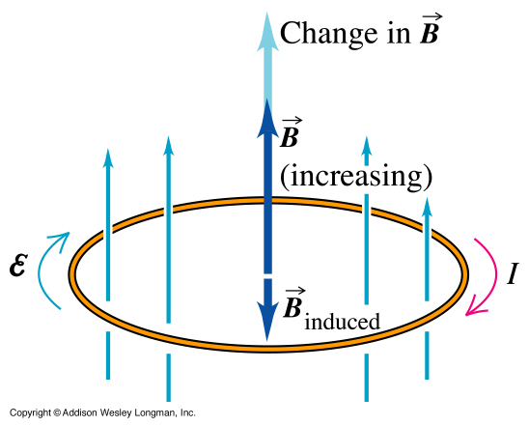
What about the minus sign in Faraday’s law?
LENZ’S LAW:
The changing magnetic flux generates an induced current which creates an induced magnetic field which, in turn, resists the change in magnetic flux.

Slide 7
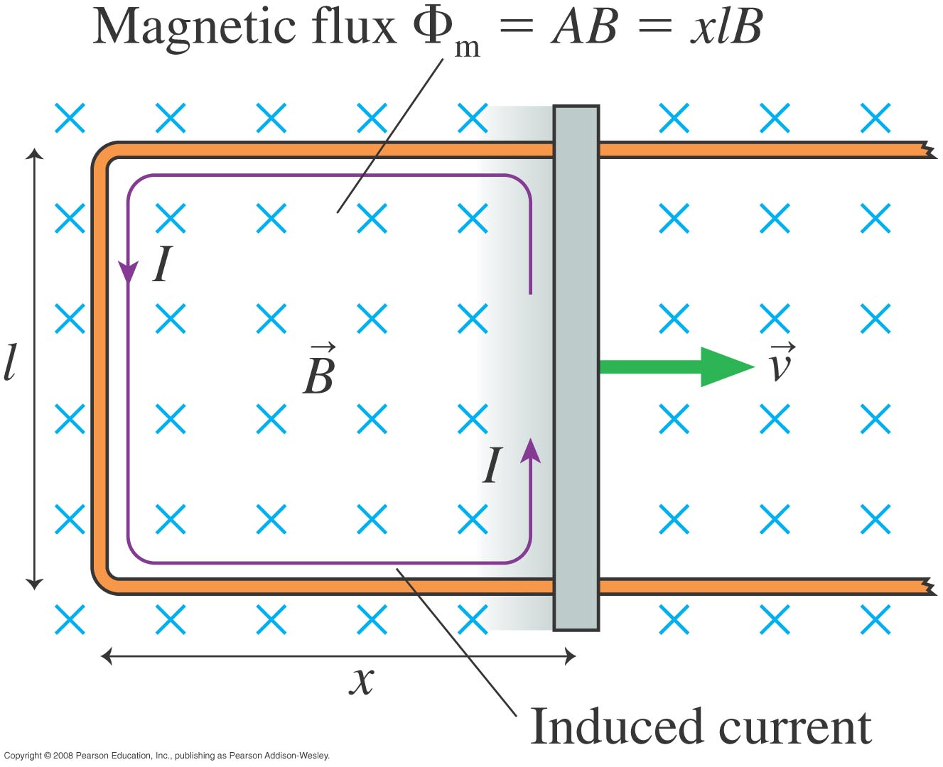

Slide 8
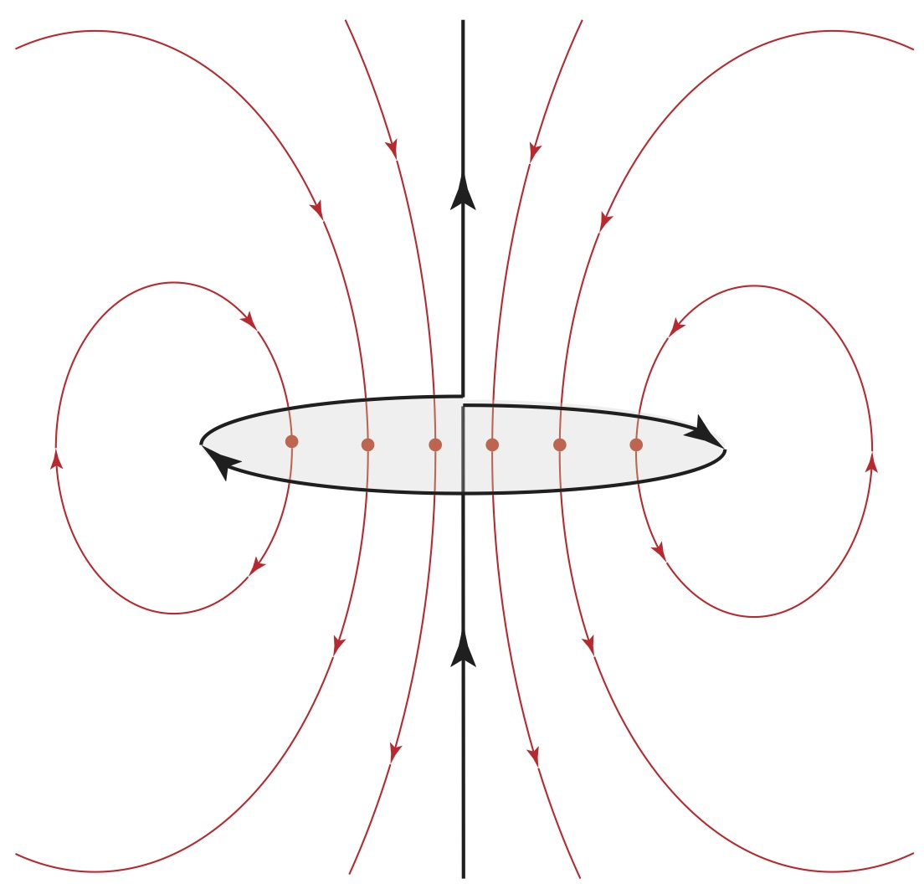
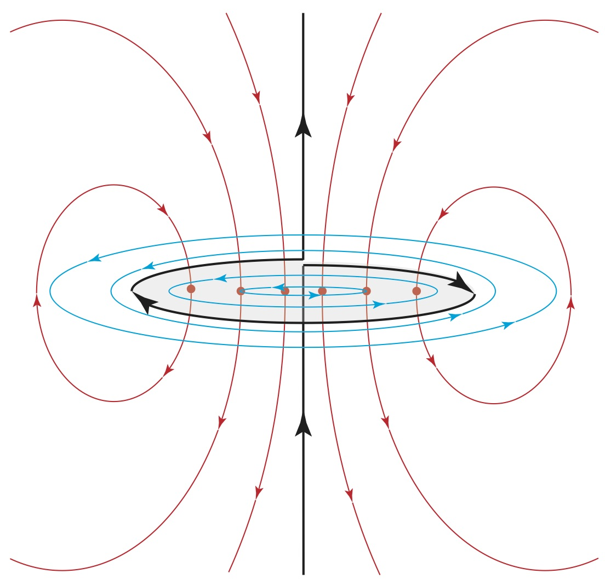
Imagine a loop in a wire carrying a current I₁. The current is then increased to I₂ > I₁, increasing the magnetic flux.
Changing B-fields induce non-conservative E-fields.

Slide 9
The current in an infinitely long solenoid with uniform magnetic field B inside is increasing so that the magnitude B increases in time as B=B₀+kt. A circular loop of radius r is placed coaxially outside the solenoid as shown. In what direction is the induced E-field around the loop ?
Top Hat Question
CW
CCW
The induced E is zero
Not enough information
r
B
Lenz’ law: induced EMF around the loop is in the CW direction. The induced E-field must therefore be in the CW direction
Notes:
Correct answer = A ➔ CW induced current
since I is increasing out of the page we want an induced current to be INTO the page

Slide 10
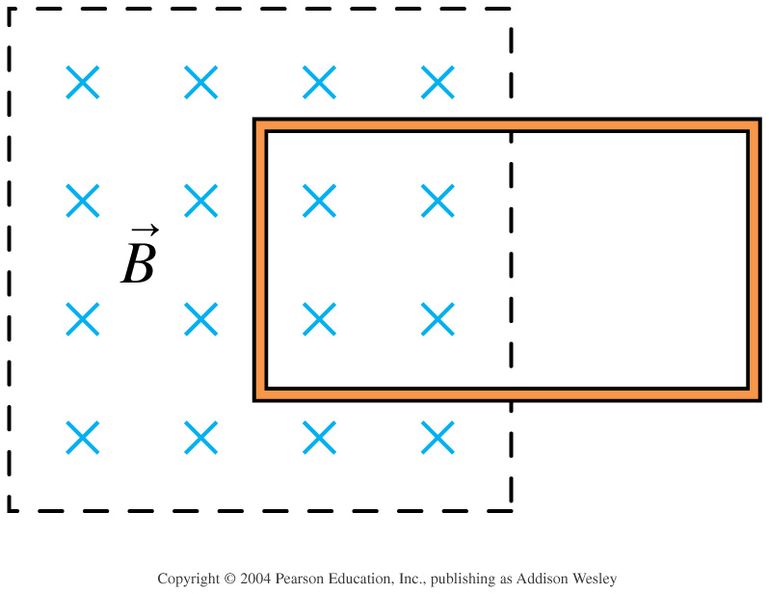
Top Hat Question
A conducting loop is halfway inside a magnetic field. Suppose the magnetic field begins to increase rapidly in strength. What happens to the loop?
C
A
B
The loop is pulled to the left, into the magnetic field.
The loop is pushed to the right, out of the magnetic field.
The loop is pushed upward, out of the magnetic field
The tension in the wire increases but the loop does not move.
Notes:
STT33.5
Answer: B

Slide 11
Top Hat Question Feedback
A conducting loop is halfway inside a magnetic field. Suppose the magnetic field begins to increase rapidly in strength. What happens to the loop?
Qualitative argument
Lenz’s Law: whatever happens must be such that it maintains the “amount of B-field” inside the loop. Since the strength of B is increasing, the loop must be pushed outside so that there are fewer B-field lines inside the loop.
Notes:
STT33.5
Answer: B

Slide 12
Top Hat Question Feedback
A conducting loop is halfway inside a magnetic field. Suppose the magnetic field begins to increase rapidly in strength. What happens to the loop?
I_{ind}
B_{ind}
F_{ind}
More rigorous argument
Lenz’s Law: B_{ind} must point out, so I_{ind} is CCW
Recall: the Lorentz force on a current carrying wire
➔
points to the RIGHT
Notes:
STT33.5
Answer: B

Slide 14
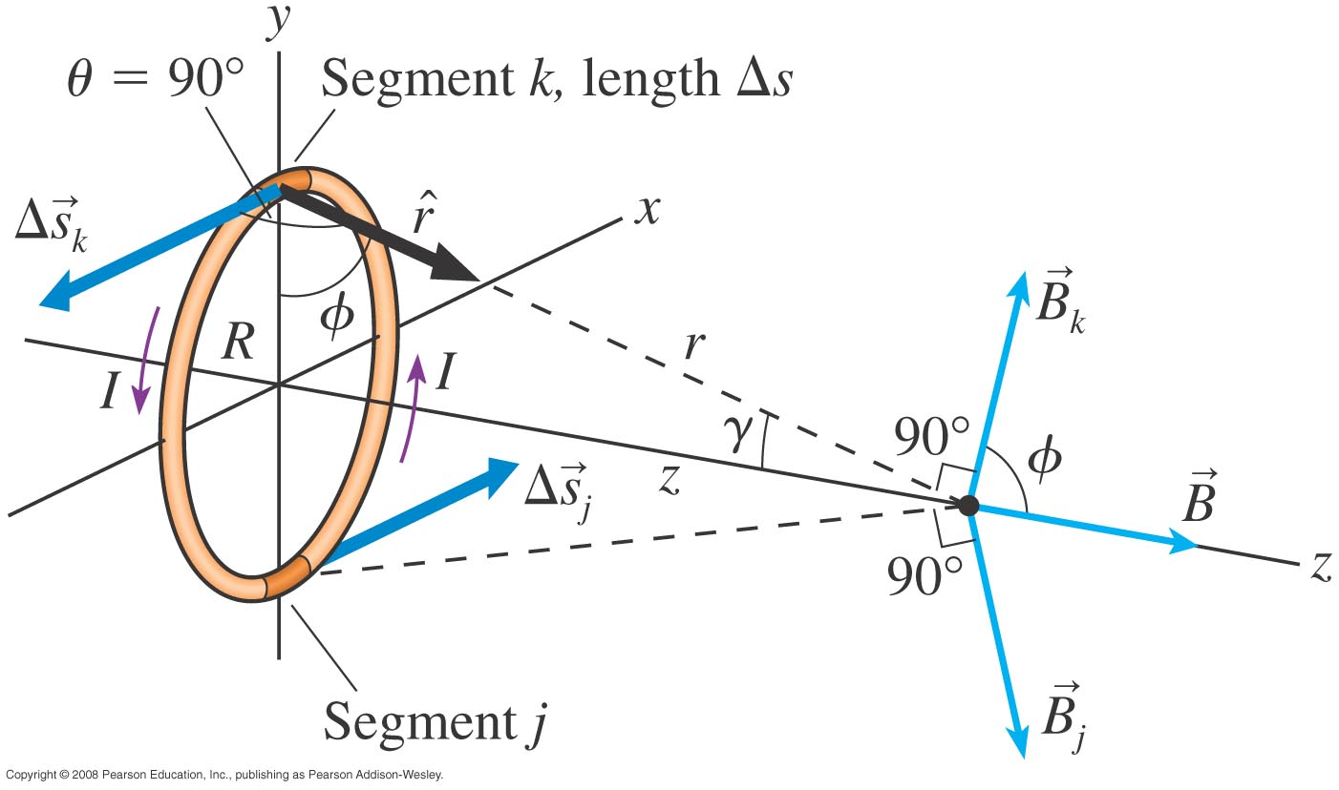
Magnetic Field of Current Loop
What is the magnetic field strength on the axis of this loop, at a distance z from the centre of the loop?
Right-hand rule:
Curl your fingers along I and your thumb gives inside the loop.

Slide 15
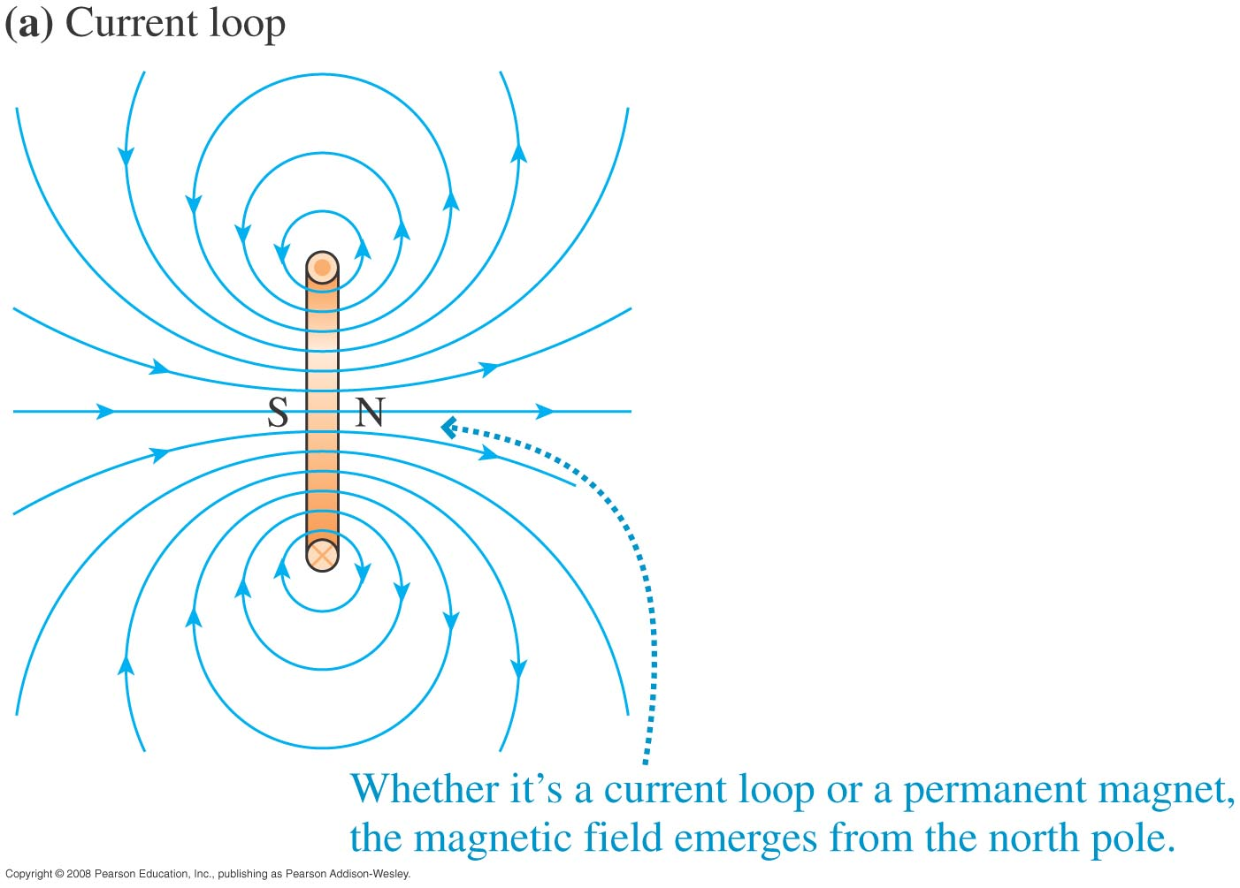
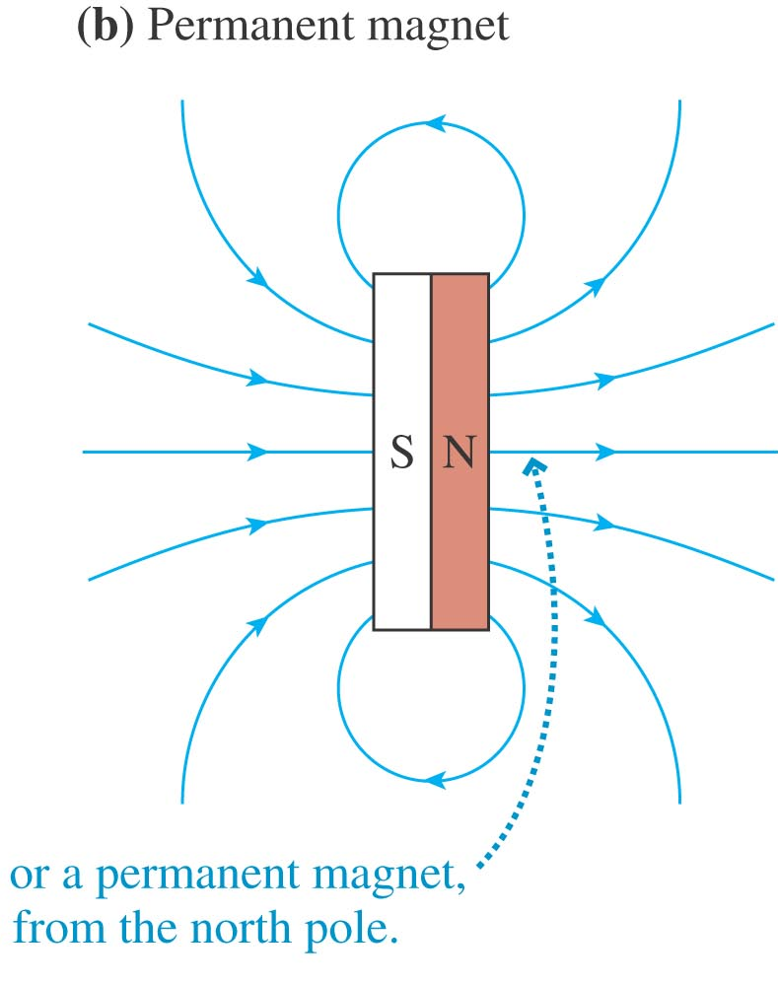
Magnetic Dipoles
So the field outside a current loop looks like the field outside a permanent magnetic of similar shape.
Two poles (N & S): magnetic dipole.

Slide 16

Magnetic Dipoles
What is B on the axis of the loop, a long way away from the loop (z >> R)?
z
B
R
on the axis of a magnetic dipole.

Slide 17
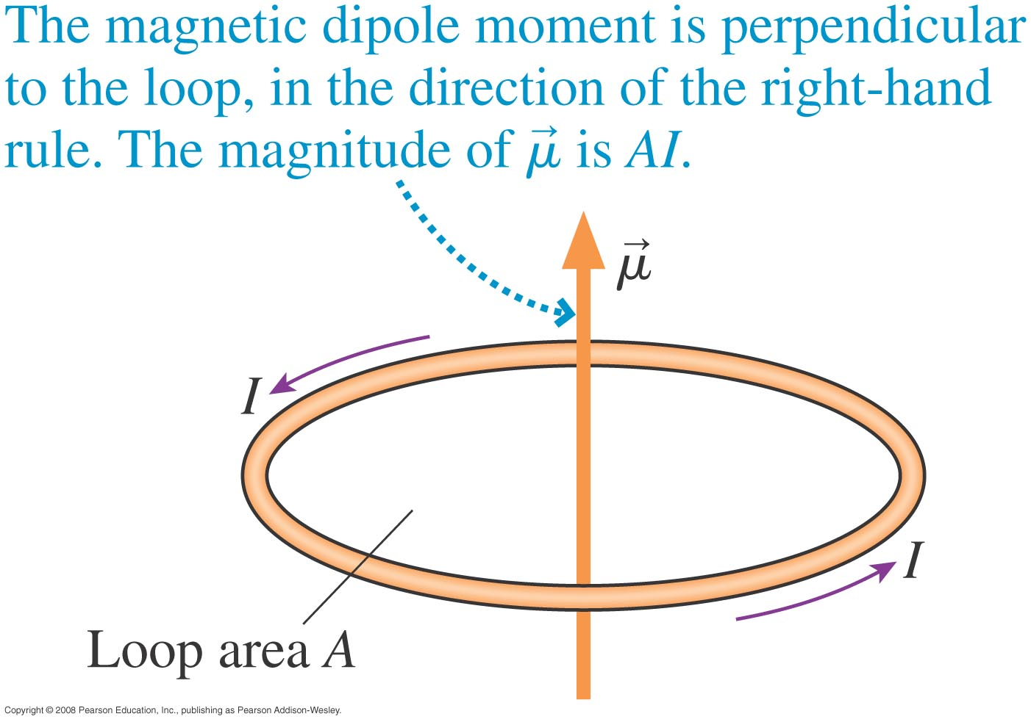
Magnetic Dipole Moment
in the direction of the right-hand rule.
Don’t confuse μ with μ₀!!

Slide 18
Top Hat Question
z
A current of 1.0 A is going through a square loop of side length 1.0 m. What is the magnetic dipole moment of this current loop?
1.0 m
1.0 m
y
1.0 A
x
C.
D.

Slide 19
Recall there are 3 possible terms:
Maxwell Equation
What about these two terms?

Slide 20
Motional EMF
There is an induced ∆V across the length of the conductor
This is equivalent to having an EMF source: “motional EMF”

Slide 21
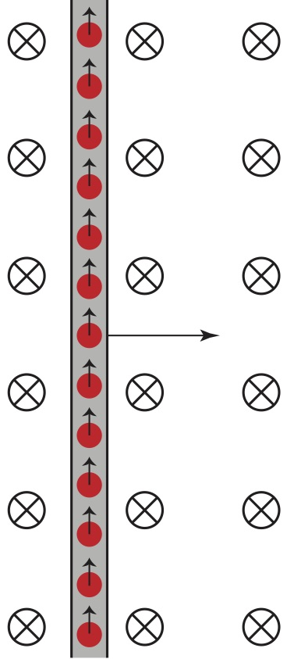
How can we quantify the induced EMF?
The free charges feel a magnetic force:
This induces a voltage difference (E-field), and therefore an electric force on the charges
MOTIONAL EMF:

